Slide 1
Additional Techniques
Route handlers
Server actions

Slide 2
Section 1: Route Handlers
Overview of route handlers
How to define a route handler
How to invoke a route handler
Demo REST service
Demo Next.js application
Route handlers example 1
Route handlers example 2
Route handlers example 3
Route handlers example 4

Slide 3
Overview of Route Handlers (1 of 2)
Imagine the following scenario:
You have a client component
You want to invoke a REST service
The REST service requires auth^{n} credentials
There's a problem here:
The client component doesn't know the auth^{n} credentials, because it would be insecure for a client to know this info
So how can the client component invoke the REST service?

Slide 4
Overview of Route Handlers (2 of 2)
The solution is to define a route handler
A route handler is part of your Next.js application
Effectively it's a server-side proxy for a REST service
Next.js app
client
component
route
handler
REST
service
Client-side
Server-side
network boundary

Slide 5
How to Define a Route Handler
To define a route handler:
Create a folder in your Next.js application
In the folder, create a file named route.js
(Note, a folder can't contain both route.js and page.js)
In route.js, define functions to handle HTTP requests
GET, POST, PUT, PATCH, DELETE, HEAD, OPTIONS
For example:
export function GET() {
… Some server-side code to invoke a REST service, e.g. to get data …
}
/app/my-apis/some-api/route.js

Slide 6
How to Invoke a Route Handler
To invoke a route handler from a client component:
It's just like calling a normal REST service…
Except the URL is just the relative path to the route handler
For example:
'use client'
export default async function SomeClientComponent() {
const response = await fetch('my-apis/some-api')
const data = await response.json()
…
}
/app/some-client-component/page.js

Slide 7
Demo REST Service
To illustrate the usefulness of route handlers, we need a REST service that we'd like to call…
We've provided a REST service in the server-api folder, which has these endpoints:
/shops
/products/*
/products-summary/*
Prepare and run as follows:
npm install
npm run start

Slide 8
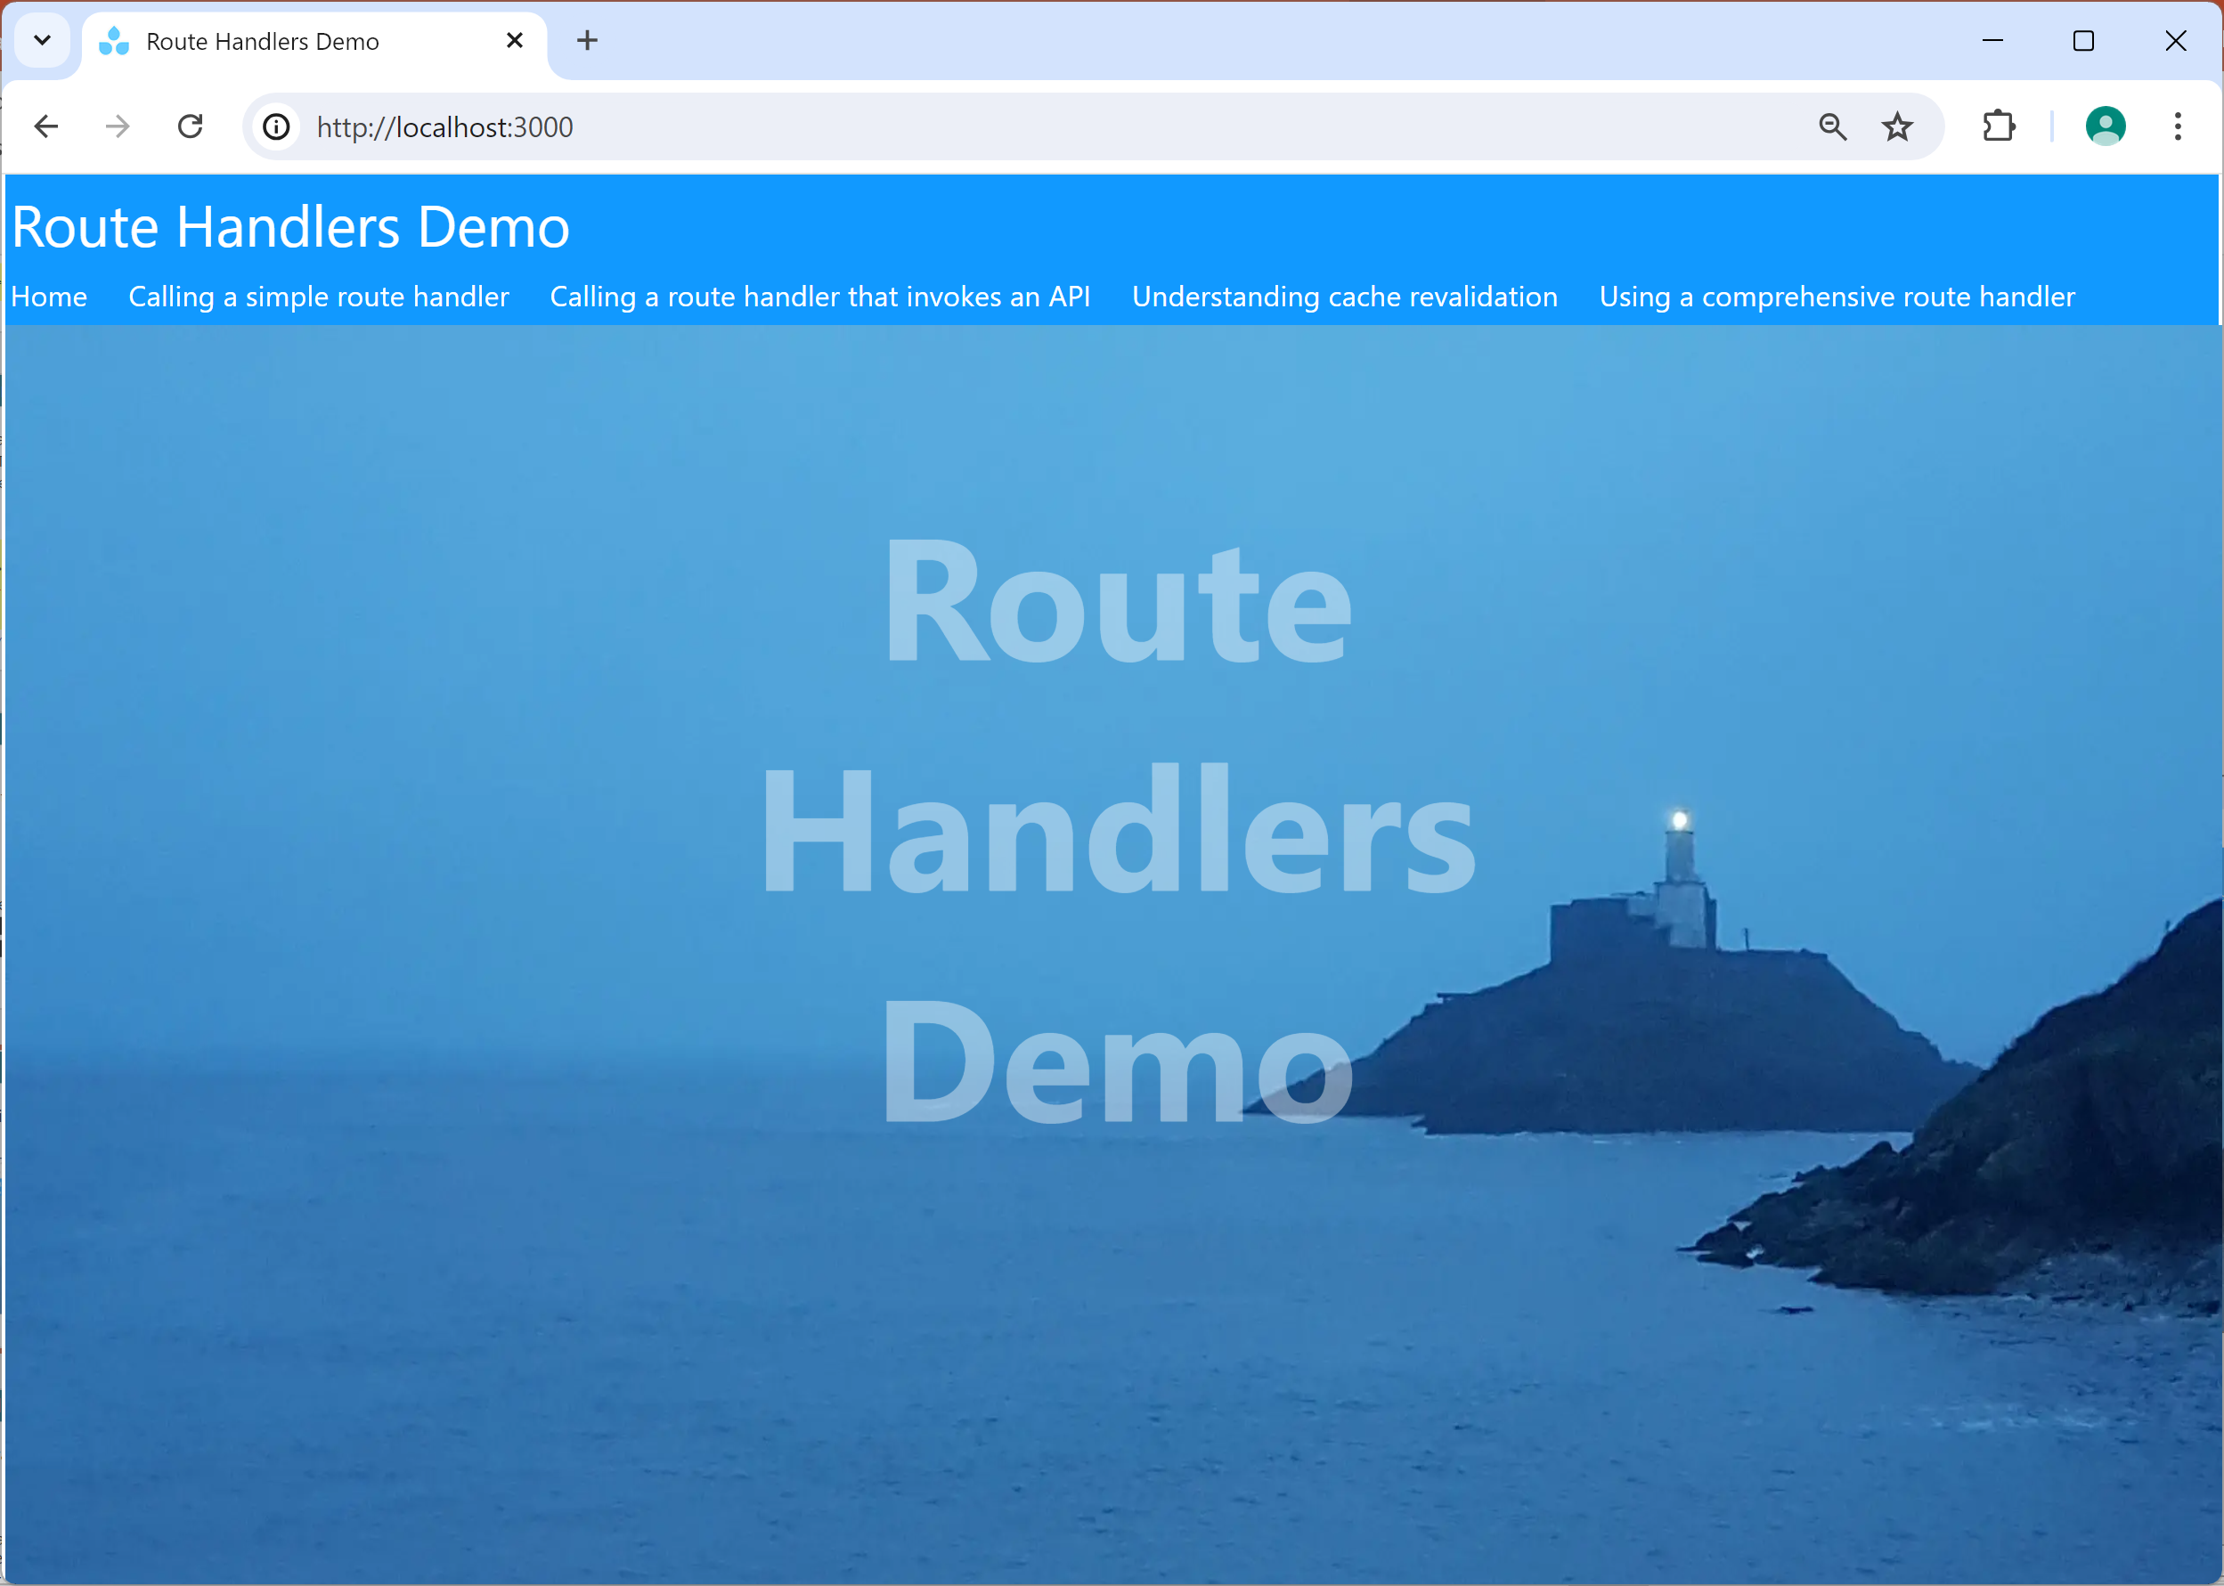
Demo Next.js Application
Now let's see a demo Next.js app that invokes the REST service endpoints via route handlers
See the demo app demo-route-handlers
Prepare and run as follows:
npm install
npm run dev

Slide 9
Route Handlers Example 1
In the Next.js demo app, see this route handler:
/app/api/timestamp/route.ts
This route handler is trivially simple, just to get started
It doesn't actually invoke a REST service
It just returns data directly (the current date and time)
We call this route handler from this client component:
/app/timestamp/page.tsx

Slide 10
Route Handlers Example 2
In the Next.js demo app, see this route handler:
/app/api/shops/route.ts
This route handler is more realistic
It invokes a REST endpoint
It passes an auth^{n} key into the request
We call this route handler from this client component:
/app/shops/page.tsx

Slide 11
Route Handlers Example 3
In the Next.js demo app, see this route handler:
/app/api/(prod-related)/products/route.ts
This route handler illustrates 2 techniques:
Revalidating the REST response in the Data Cache (10 secs)
Handling search parameters in a route handler
We call this route handler from this client component:
/app/products/page.tsx

Slide 12
Route Handlers Example 4
In the Next.js demo app, see these route handlers:
/app/api/(prod-related)/product/[[...id]]/route.ts
/app/api/(prod-related)/product-count/route.ts
/app/api/(prod-related)/product-value/route.ts
These route handlers illustrate "CRUD" REST calls:
CREATE (POST), READ (GET), UPDATE (PUT), DELETE (DELETE)
We call these route handlers from this client component:
/app/product/page.tsx

Slide 13
Section 2: Server Actions
What are server actions?
Invoking a server action from a component
Demo application
Understanding the demo application code

Slide 14
What are Server Actions?
Server actions are asynchronous functions that run on the server, to do something useful at the server
Callable from client components and server components
'use server'
…
export async function someServerAction() {
… Do some useful server-side operation …
}
my-server-actions.tsx

Slide 15
Invoking a Server Action from a Component
A component can invoke a server action in many ways:
Via a regular function call
Via a browser event handler
Via a useEffect() hook
Via a <form> submission
When you invoke a server action:
An HTTP POST request is sent to the server
Any arguments/returns must be serializable by React

Slide 16
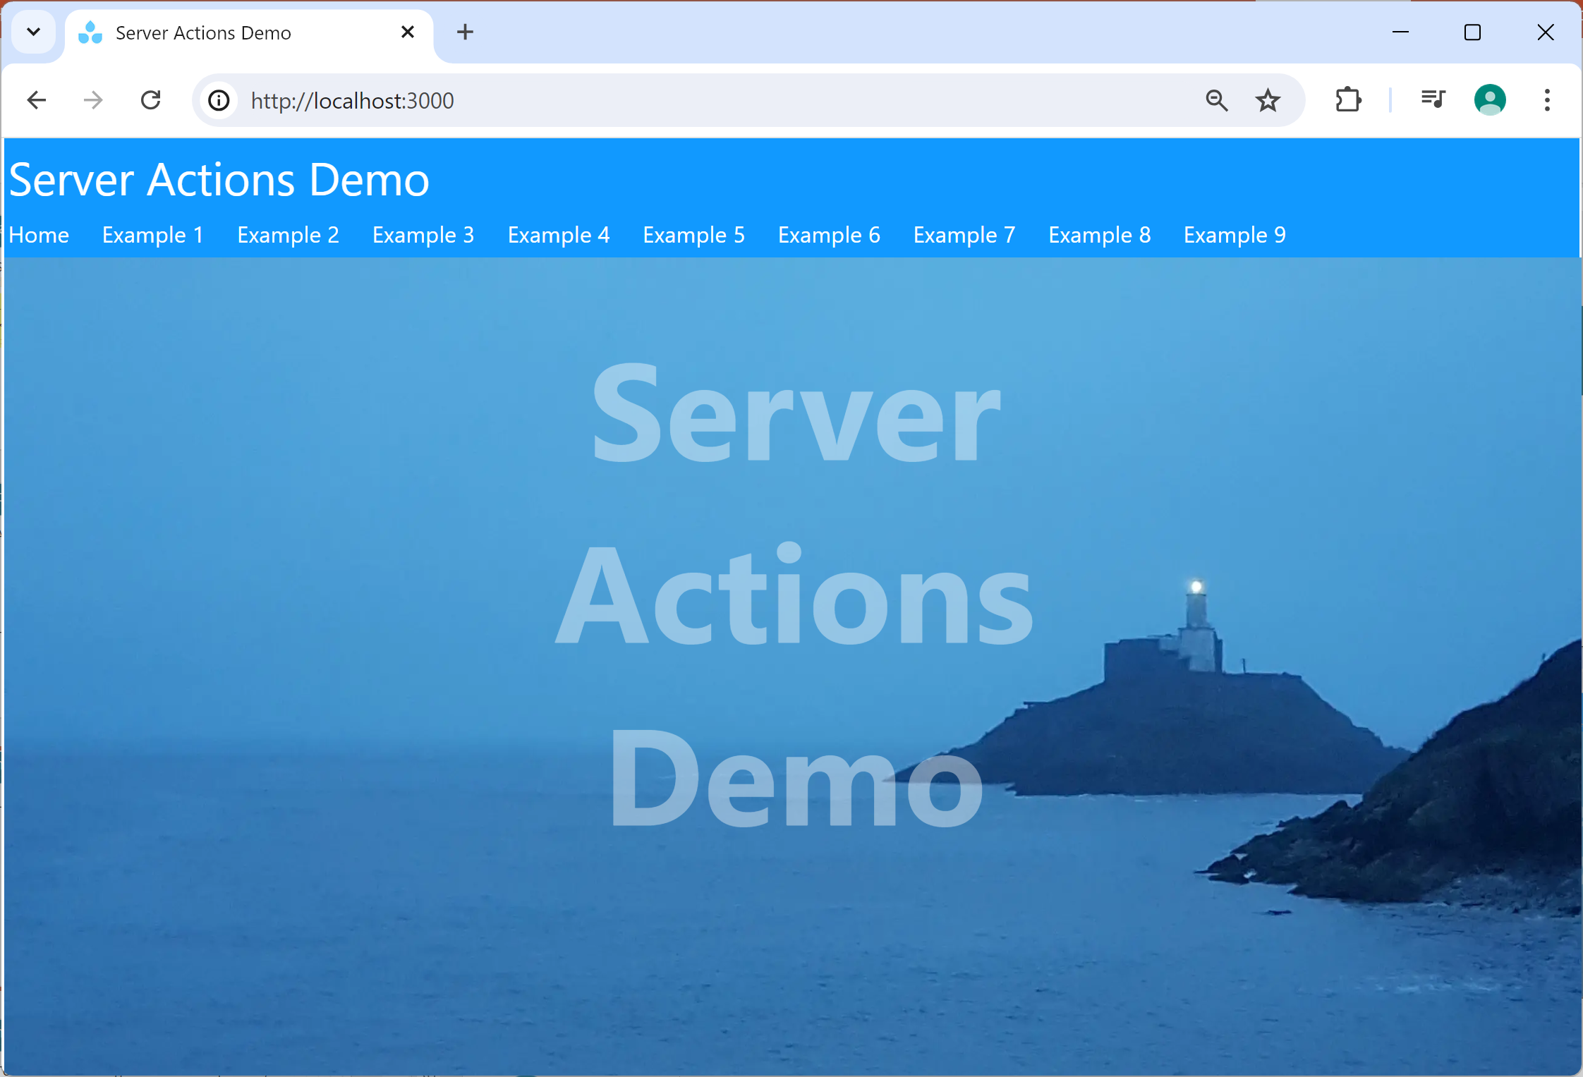
Demo Application
Let's see a demo how to define/invoke server actions
See the demo app demo-server-actions
Prepare and run as follows:
npm install
npm run dev

Slide 17
Understanding the Demo Application Code
The demo application contains various server actions, all housed in the same file (for convenience):
/app/my-server-actions.ts
The demo application has 9 separate components that illustrate various server action techniques:
/app/example1/page.tsx, etc.
There are plenty of comments in the code to explain what's happening 👍

Slide 18
Summary
Route handlers
Server actions

